Slide 1
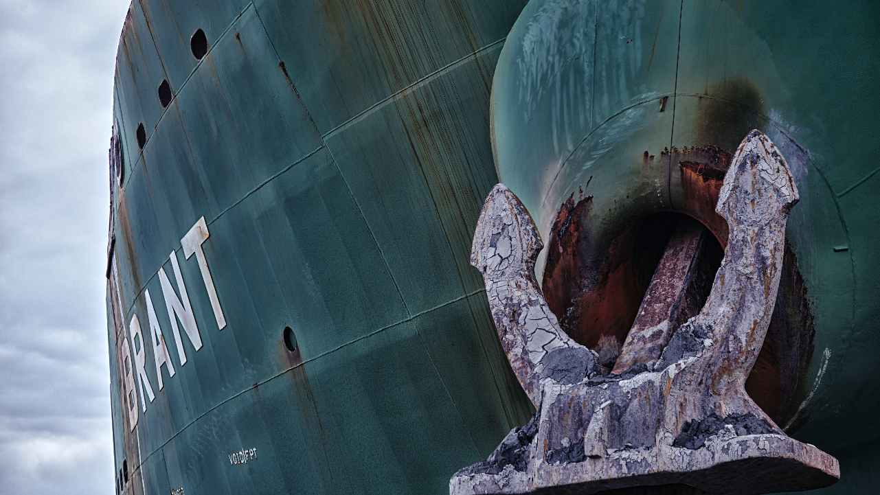

Louisiana Ports Deliver
Presented By: Jennifer Marusak, MA, CPE, Executive Director

Slide 2
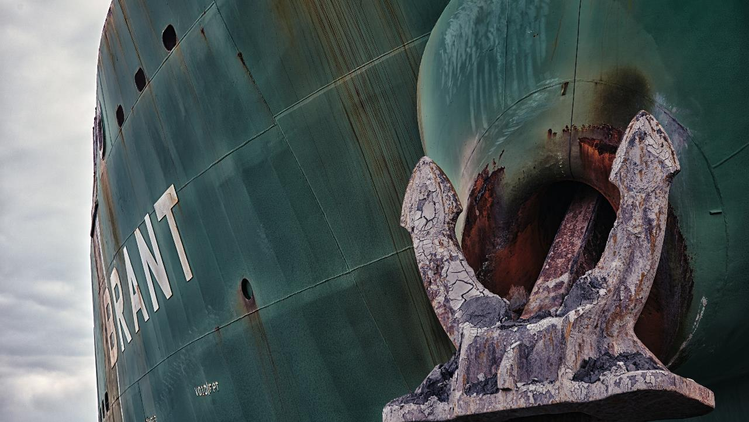
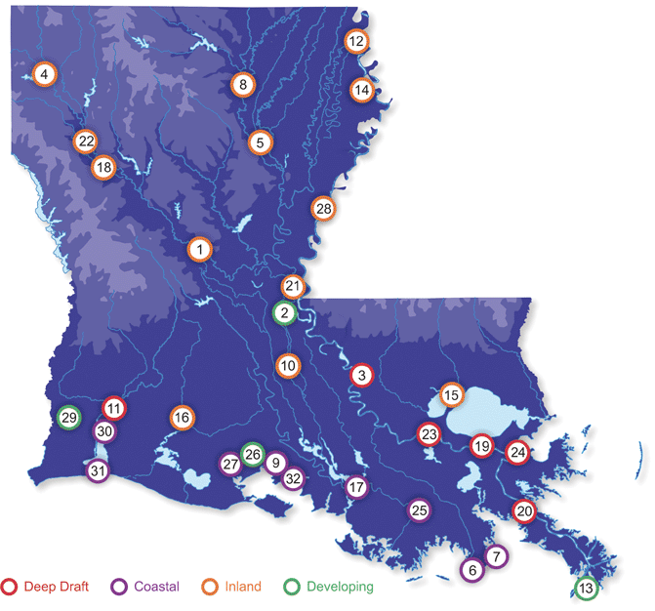
Ports Impact Every Region of Louisiana
1. Central Louisiana
Regional Port
2. Avoyelles
3. Greater Baton Rouge
4. Caddo-Bossier
5. Columbia
6. Fourchon
7. Grand Isle
8. Greater Ouachita
9. Iberia
10. Greater Krotz Springs
11. Lake Charles
12. Lake Providence
13. LIGTT
14. Madison Port
15. Manchac
16. Mermentau
17. Morgan City
18. Natchitoches
19. New Orleans
20. Plaquemines
21. Pointe Coupee
22. Red River
23. South Louisiana
24. St. Bernard
25. Terrebonne
26. Twin Parish
27. Vermilion
28. Vidalia
29. Vinton
30. West Calcasieu
31. Cameron Parish
32. West St. Mary
Port Facts
33 Corporate Members
86 Associate Members

Slide 3
Mississippi River is the Backbone of the Nation’s Water Commerce
Five Mississippi River ports comprise the largest port complex in the world
Louisiana ports carry 25% of U.S. waterborne commerce
60% of the nation’s grain
20% of the nation’s coal
14,500 mile inland waterway system including rivers & intracoastal waterways

Slide 4
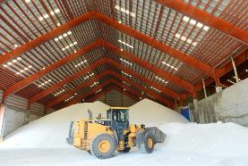
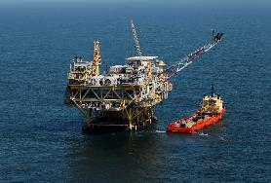
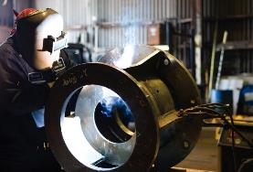

Ports Connect & Enhance Markets for Major Industries
Transportation & Warehousing
Mining –
Includes Oil & Gas
These industries anchor the
Louisiana economy
These industries could exist without ports but with much higher costs
These industries are high volume exporters & importers
Manufacturing
Agriculture

Slide 5
Importance of Deep Draft Ports
Port of South Louisiana | Ranks #1 in the western hemisphere for most tons of cargo transported through its public/private docks; imports/exports more than 300 million tons annually
Port of Lake Charles | Center for LNG operations; $85 Billion natural gas related industrial development
St. Bernard Port | Ships 36% of the nation’s ferroalloys; handles bulk & breakbulk; home to one of the nation’s only ISO tank cleaning facilities
Plaquemines Port | Slated to construct 20 million metric ton LNG export facility; More than 55 million tons of grain, petrochemicals & coal pass through annually
Port of New Orleans | Multimodal transportation hub and an economic engine driven by diverse lines of business: extensive cargo capabilities, a strategically aligned railroad, a large industrial real estate portfolio and in-demand cruise operations. Port NOLA’s diverse business lines include Louisiana’s only international container terminal, growing the nation’s largest container-on-barge service, 6th largest cruise port in the nation, New Orleans Public Belt Railroad connections to six Class 1 railroads, world-class breakbulk terminals.
Port of Greater Baton Rouge | Strategically located at the head of deep-water navigation on the Mississippi River and possessing robust maritime infrastructure capable of handling general, breakbulk, liquids and containerized cargoes, with a continued mission of promoting domestic and international commerce

Slide 6
Importance of Coastal Ports
Louisiana is the 2nd Largest Producer of Crude Oil & 2nd Largest Producer of Natural Gas in the U.S.
Port of Terrebonne, Port of Morgan City, Port of Vermilion & Port of Iberia | Oil & gas industry fabrication and supply base Terrebonne slated to create 735 new jobs
West Calcasieu Port | Anchors GIWW in SW La. - enables maritime-oriented services – barge fleeting, barge cleaning/repair (wet/dry), marine fueling, marine construction, diesel engine repair, construction equipment refurbishing.
Port Fourchon | Services 90% of all deep-water rigs in Gulf of Mexico Services 50% of all shallow-water rigs in Gulf of Mexico (18% of U.S. oil supply)
Cameron Parish Port, Harbor & Terminal District | $35 billion in LNG export facilities, making Cameron Parish 3rd among nations in LNG export. Both a coastal and deep-water port. Contains 44 miles of GIWW & 33 miles of deep water.

Slide 7
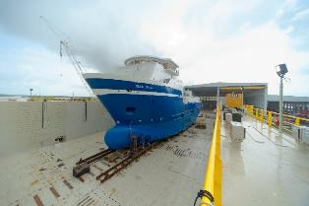
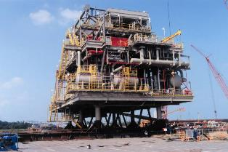
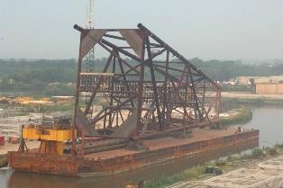
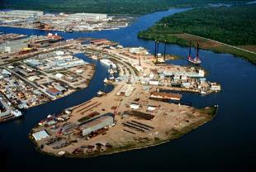
Importance of Inland Ports
Inland Ports Link Farmers to Global & National Markets
Provide Warehousing & Value-Added Services
Attracts Manufacturing, Distribution & Other Industries – Creating Jobs in Their Communities
Lake Providence | Largest tonnage of inland ports for agricultural products Fastest growing inland port in the U.S.
Port of Caddo-Bossier | 4,000-acre industrial park and inland multi-modal distribution center with more than 16 companies; drives industrial growth in north Louisiana
Port of Krotz Springs | 134 waterfront acres; 3.1 million overall annual tonnage

Slide 8
What constitutes a crisis?
Federal Policy
Action/inaction by Congress
Action/inaction by Administration
State Policy
Action/inaction at the Legislature
Action/inaction by Administration
Misinformation
Hurricanes

Slide 9
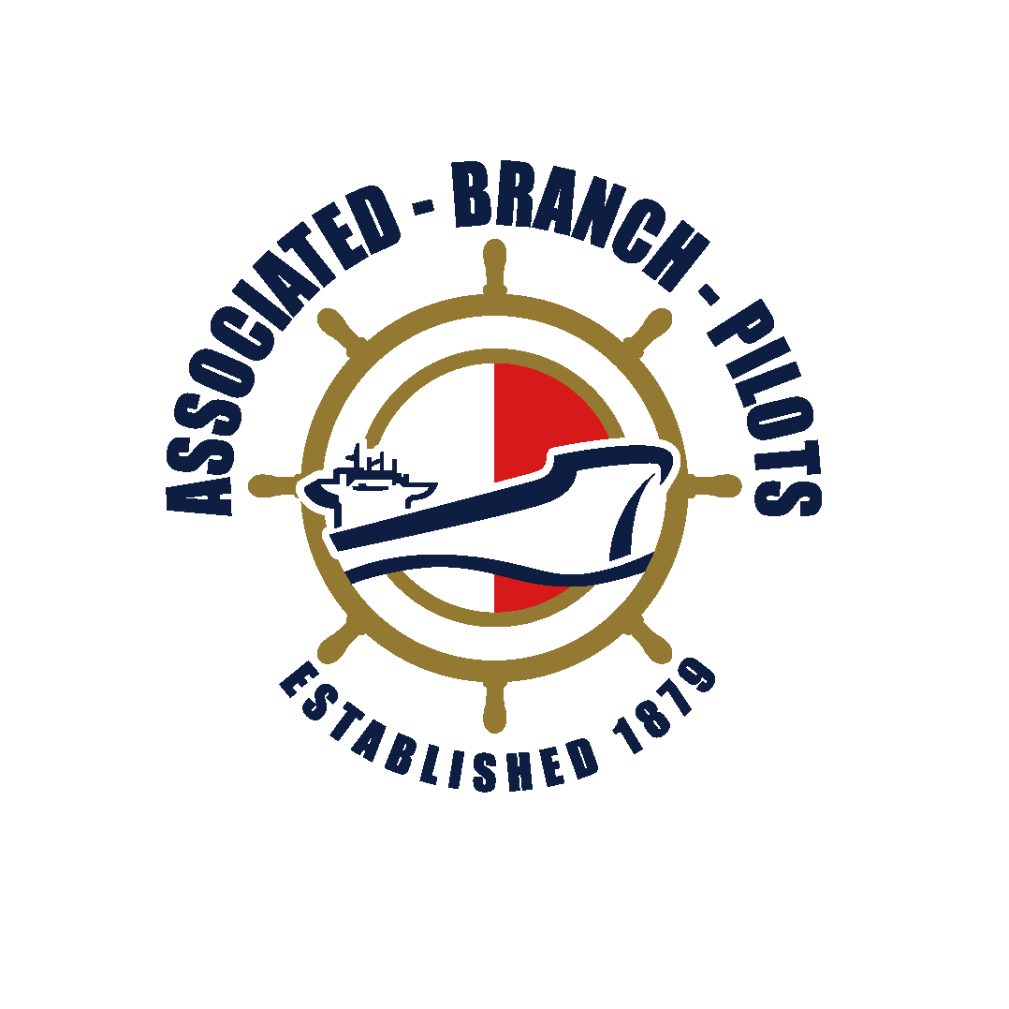


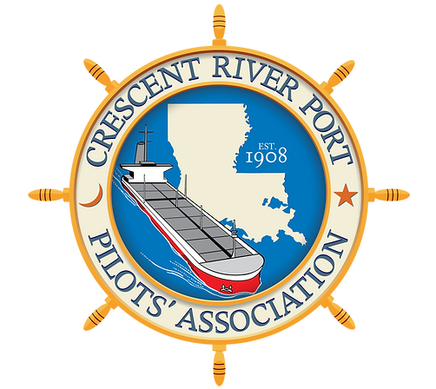
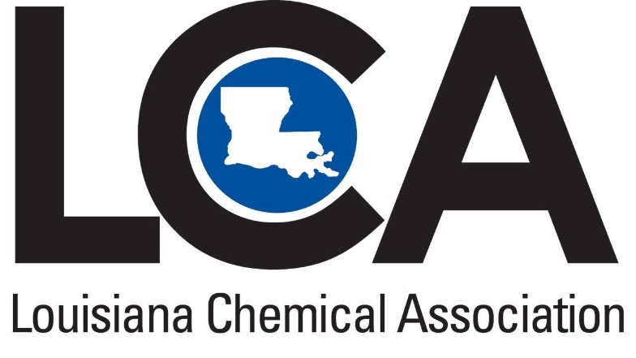

Additional Partners & Stakeholders

Slide 10
The Usual Subjects
U.S. Coast Guard
MARAD
Louisiana Department of Transportation & Development
Louisiana Economic Development
Louisiana Coast Protection & Restoration Authority

Slide 11

Thank You
www.PortsofLouisiana.org
jmarusak@bellsouth.net

